Slide 1

Central Board of Secondary Education

Slide 2

HOLISTIC PROGRESS CARD (HPC)

Slide 3
NEP Mandate: GOALS
1
Ensuring that the primary purpose of assessment is to promote the learning and development of students.
2
Focus on regular formative assessment for learning rather than a summative assessment that encourages today’s ‘coaching culture'
The shift from testing rote memorization skills to competency-based and testing higher-order skills such as analysis, critical thinking, and conceptual clarity.
3
Enabling assessment to help the school system to continuously revisit teaching-learning processes to optimize the learning and development of all students.
4

Slide 4
NEP Mandate: PROCESS
1
Provisions for self-assessment and peer assessment along with teacher assessment.
Along with paper-pencil tests, the scope for alternate assessment procedures that record the progress of children in project-based and inquiry-based learning, quizzes, role-plays, group work, portfolios etc.
2
Development of a 360-degree holistic multidimensional Progress Card which would reflect the progress as well as the uniqueness of each learner in the cognitive, affective, and psychomotor domains; and be an important link between parents and teachers. (Para 4.35)
3
Development of interactive software to enable students to track their progress and get information on their strengths, areas of interest and needed areas of focus.
4

Slide 5
Why HPC?
Grades do not give a clear picture of student learning. What are the substitutes ?
What do parents, teachers and students want to know from a progress card ?
What are the various ways in which the school can communicate progress?
Performance is never static ,it has to be measured over a period of time.

Slide 6
How does the Progress report provide feedback for the student ,so as to facilitate progress in learning?
How does a Parent know the uniqueness in their child?
How can the Progress be a log of performance and conversation with Parents and students?
Is it possible to help parents see the connections and possibilites of the direction in which the student is growing ?
How can the teacher`s burden to fill in progress reports be decreased?

Slide 7
All above questions/premise can be answered by the HPC that will be:
01
A Pedagogical Tool
A Process through which both the teachers and the parents will equally participate for the student achievement of competencies
02
03
A Tool to enable society to participate in a student's development and progress

Slide 8
HPC is , thus, a Collaborative endeavor.
Parents
Teachers
HPC
Learner
Peers

Slide 9
AIM & SPIRIT OF HPC
The process of learning needs to be given more importance than the product.
Assessment ‘As’,
‘Of’ and ‘For’
learning
Provide insights regarding the learner's strengths, areas of interest as well as scope for improvements
Be a dynamic and continuous process aiding the growth and the development of the learner instead of assessing or judging the final outcome only

Slide 10
Recommended to include multiple forms of assessment tools having varying and flexible formats (e.g. objective to descriptive, visual, or any other format)to assess all aspects of development in their entirety
Trace the progress or all-round development of the learner
Acknowledge and celebrate the uniqueness of each learner

Slide 11
FEATURES OF HPC
Participatory and learner centric approach
Inclusive
Assess the task and not the learner - Assess the ability of the child to complete an assessment according to defined competencies and skills continuously.
Builds on self-awareness and self-esteem: The HPC communicates the strengths and areas of improvement with participation and discussion between the teacher, the child and where possible, the parent.

Slide 12
Goal setting: The HPC includes opportunities for the child in consultation with the teacher to set future goals thus providing direction to both, teacher and the child in terms of future action.
Tracks skills and competencies: Assesses the competencies and skills as laid down in NIPUN
Inter-disciplinary: The HPC encourages and offers possibility for inter-disciplinary task assessment under which individual tasks can be assessed, in alignment with the recommendations of the NEP 2020 to break the subject silos.
Flexible: Activities/ Tasks, Prompts, Templates and formats will be provided to the teacher. And, there will be a possibility to customise them according to a school’s individual needs, making the HPC a flexible tool.

Slide 13
Structure
Section 1
Developmental Goals and Competencies
Section II
Section III
STRUCTURE OF HPC
Portfolio
Parents’ Feedback
.

Slide 14
HPC Format
This is a suggestive exemplar card based on the NIPUN BHARAT Guidelines prepared for classes Pre-school 1 to grade 3.
CBSE affiliated schools may adopt / adapt the card as per their requirement, context, locality and priorities.
This card is an individualized and comprehensive representation of a student’s progress.
HPC builds on continuous assessment to present a picture of the student’s progress across a specific time. It provides disaggregated reporting, unlike a single score or letter grade in a subject area.
A comprehensive list of age/grade-wise outcomes is given in the Foundation Literacy and Numeracy Framework NIPUN which are expected to be covered during classroom sessions.
However, for the purpose of reporting the progress of a student, selected competencies that represent the critical areas of instruction and development are highlighted in this Card along with each developmental goal.

Slide 15
These Competencies are year-long expectations and are to be measured with the following scale:
LEVEL | INTERPRETATION
Beginner | The student is at the beginning stage of the target competency and needs a great deal of support and handholding.
Progressing | The student is able to meet some part of target competency independently but needs some (occasional) support and handholding.
Proficient | The student is able to meet the target competency independently, without any support.
These goals are to be met with the use of activity-based and experiential learning pedagogy by the teacher to enable a child to develop competencies. Observation and discussions by a teacher are also integral part of pedagogy required.

Slide 16
When a child is at the beginner level, it would be desirable that a teacher include a narrative how she/he will support the child and what parental support is required.
For the purpose of representation of the level in the card, schools must select any non-hierarchical and neutral icon such as a flower, tree, smiley etc.
Teachers must keep the record of the baseline level for each student at the beginning of the session. Child’s records of the previous class can be the baseline.
The Progress Card document is a combination of a child’s own expression of self as well as the teacher’s assessment of the child on the mentioned standards. There is also a section on Self-Assessment and Peer Assessment, which shall reflect child’s self-reflection and peer-reflection on the basis of some tasks of activity-based/ experiential learning.

Slide 17
This gives a complete picture of the child and provides an evidence as well as an opportunity to the child to present her growth in the progress review over years.
Finally, a pictorial evidence of the child’s work is represented in the portfolio section. This will essentially present the child’s work in the task assigned.

Slide 18
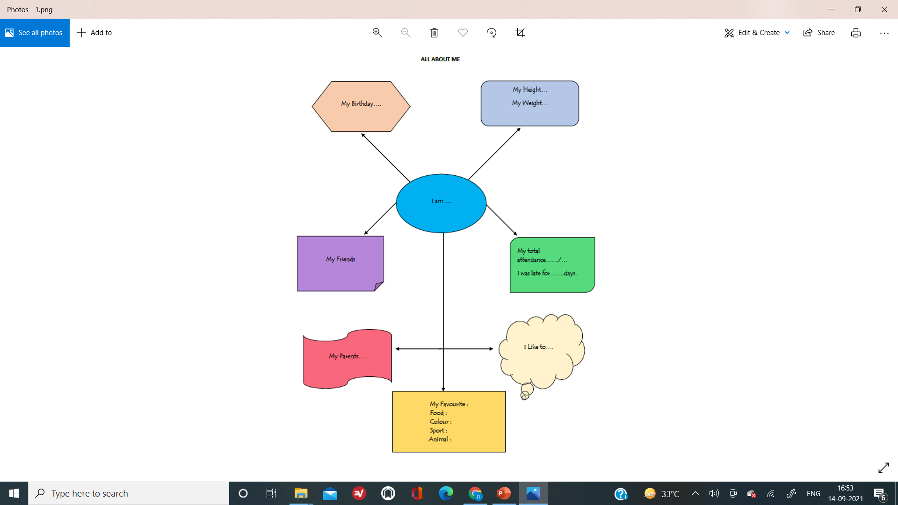

Slide 19
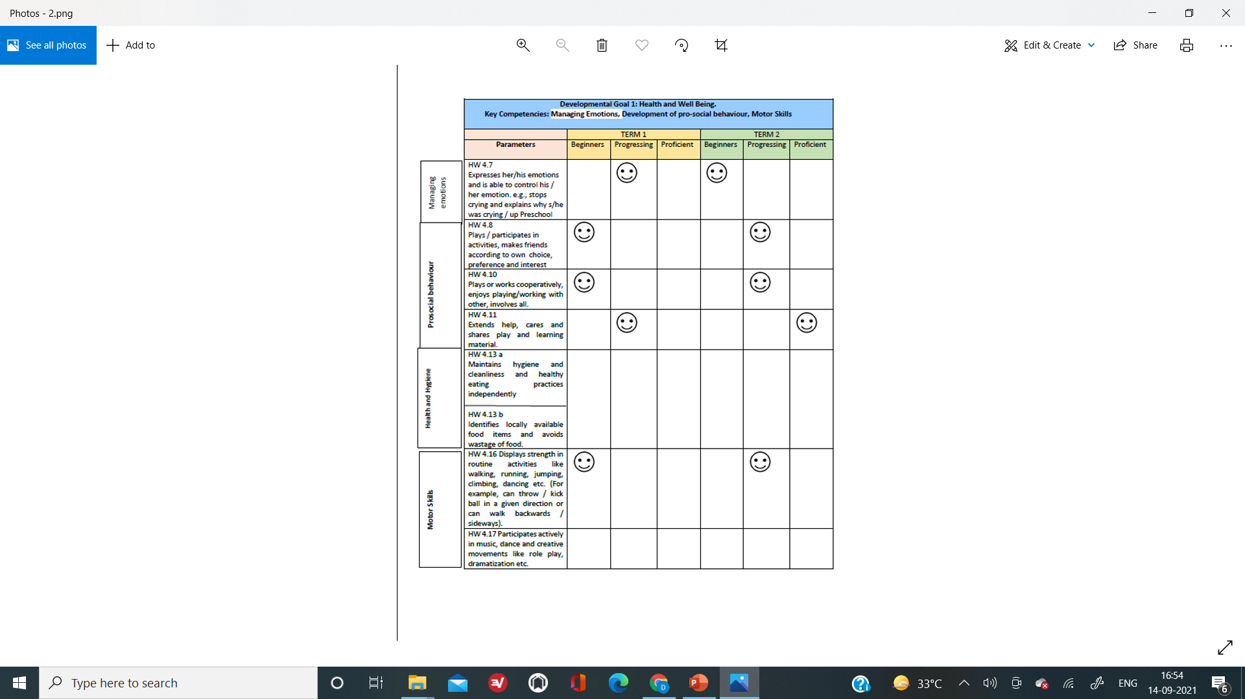

Slide 20
THANK YOU!

